Slide 1
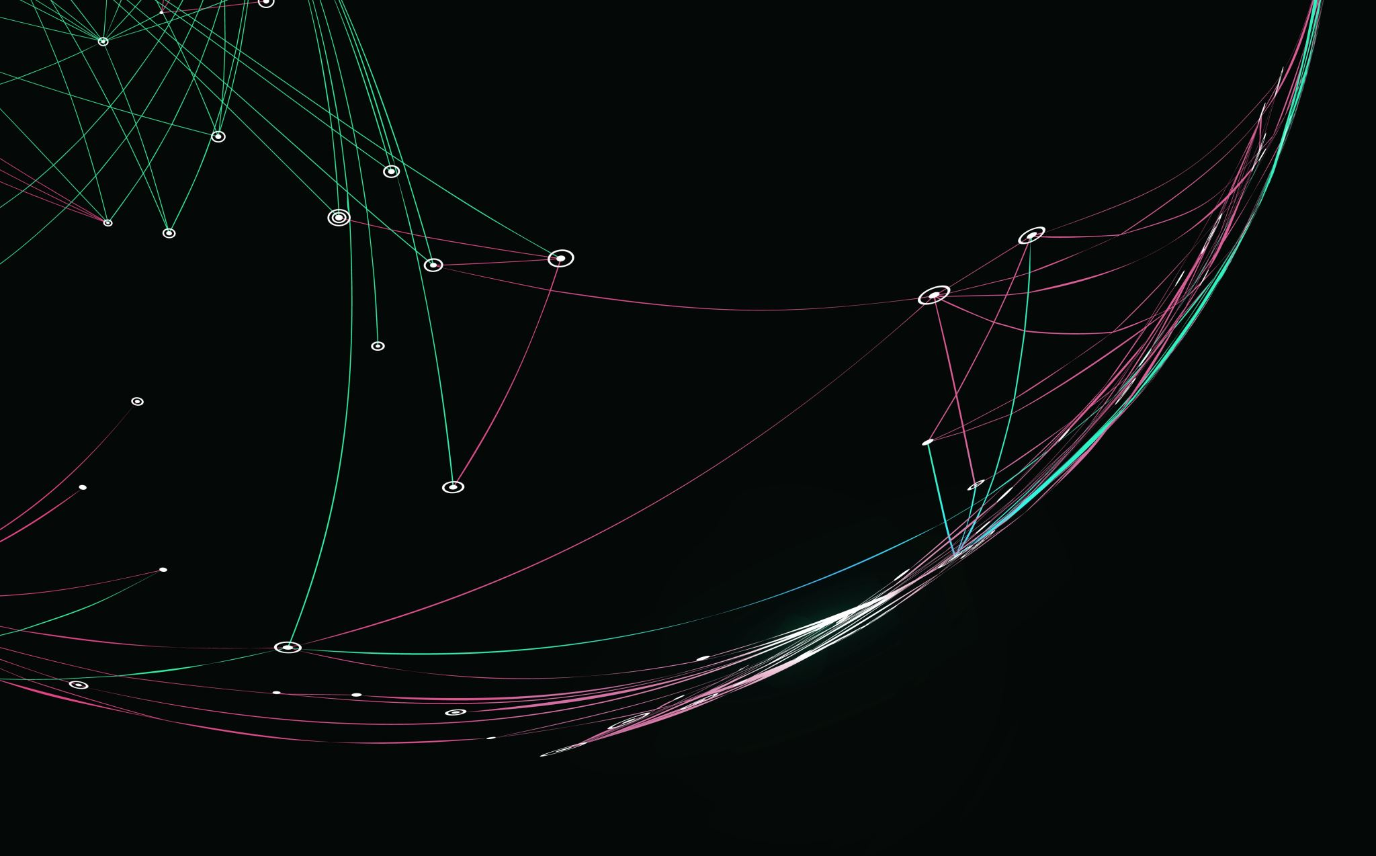
PP2 - Wireframes
QuizPro
Code Institute

Slide 2


Mobile Landing Page -
Mobile Landing Page -
– Once options selected the ‘Start’ game button is visible
Mobile Landing Page -
– How to Play Modal
QuizPro
QuizPro
How to Play
You're journey to becoming a QuizPro starts here!
You're journey to becoming a QuizPro starts here!
How to Play
How to Play
- Select a difficulty level: 'Easy', 'Medium', or 'Hard’.
- Select a topic from the 'Select Category' dropdown menu.
- Select the number of questions from 'Select Number of Questions' dropdown menu.
- Click the 'Start Quiz' button to begin the quiz.
- Select an answer from one of the choices and click the 'Submit' button.
- Click the 'Next' button to move to the next question.
-When the quiz is over you will get your quiz results.
- Click the 'Play Again' button to return to the Home screen.
-- Select Difficulty Level
Easy
-- Select Category
General Knowledge
-- Select Number of Questions
5
Start
Close

Slide 3
Desktop Landing Page
QuizPro
You're journey to becoming a QuizPro starts here!
How to Play
-- Select Difficulty Level
-- Select Category
-- Select Number of Questions

Slide 4
Desktop Landing Page - How to Play Modal
How to Play
- Select a difficulty level: 'Easy', 'Medium', or 'Hard’.
- Select a topic from the 'Select Category' dropdown menu.
- Select the number of questions from 'Select Number of Questions' dropdown menu.
- Click the 'Start Quiz' button to begin the quiz.
- Select an answer from one of the choices and click the 'Submit' button.
- Click the 'Next' button to move to the next question.
-When the quiz is over you will get your quiz results.
- Click the 'Play Again' button to return to the Home screen.
Close

Slide 5
Desktop - Once options selected the ‘Start Quiz’ button is visible
QuizPro
You're journey to becoming a QuizPro starts here!
How to Play
Medium
Sport
10
Start Quiz

Slide 6

Desktop Quiz – select answer screen
QuizPro
Question: 1 of 10
Which sign of the zodiac comes between Virgo and Scorpio?
Libra
Capricorn
Taurus
Gemini
Submit Answer
Correct: 0
Incorrect: 0

Slide 7
Desktop Quiz – Once answer selected, radio button turns yellow
QuizPro
Radio button turns yellow when a user clicks on an answer
Question: 1 of 10
Which sign of the zodiac comes between Virgo and Scorpio?
Libra
Capricorn
Taurus
Gemini
Submit Answer
Correct: 0
Incorrect: 0

Slide 8
Desktop Quiz – If submitted answer is Incorrect, Background colour turns red, incorrect counter increments
Background colour turns red if answer is incorrect
QuizPro
Question: 1 of 10
What was the first ever London Underground line to be built?
Circle Line
Bakerloo Line
Metropolitan Line
Victoria Line
Next Question button is displayed
Incorrect counter increments
Next Question
Correct: 0
Incorrect: 1

Slide 9
Desktop Quiz – Once selected answer is submitted the ‘Next Question’ button is displayed
Background colour turns light green if answer is correct
QuizPro
Question: 5 of 10
The drug cartel run by Pablo Escobar originated in which South American city?
Bogotá
Quito
Cali
Medellin
Correct counter increments
Next Question button is displayed
Next Question
Correct: 3
Incorrect: 2

Slide 10
Desktop Quiz – End of Game Message – different messages are displayed depending on players score
Congratulations! You answered all questions correctly.
You are a true QuizP
QuizPro
Message displayed when Player answers less than 25% of questions correctly
😞 Better Luck Next Time 😞
🙁
You answered 1 of 5 questions correctly.
Don't give up, keep learning!
Play Again

Slide 11
Desktop Quiz – End of Game Message – different messages are displayed depending on players score
Congratulations! You answered all questions correctly.
You are a true QuizP
QuizPro
Message displayed when Player answers between 25% and 50% of questions correctly
😊 Good Effort 😊
👍
You answered 4 of 10 questions correctly.
You're making progress!
Play Again

Slide 12
Desktop Quiz – End of Game Message – different messages are displayed depending on players score
Congratulations! You answered all questions correctly.
You are a true QuizP
QuizPro
Message displayed when Player answers between 50% and 75% of questions correctly
👏 Well Done! 👏
🏅
You answered 7 of 10 questions correctly.
Remember practice makes perfect!
Play Again

Slide 13
Desktop Quiz – End of Game Message – different messages are displayed depending on players score
Congratulations! You answered all questions correctly.
You are a true QuizP
QuizPro
Message displayed when Player answers between 75% and 90% of questions correctly
👏👏 Awesome! 👏👏
⭐
You answered 16 of 20 questions correctly.
Keep trying for a perfect score!
Play Again

Slide 14
Desktop Quiz – End of Game Message – different messages are displayed depending on players score
Congratulations! You answered all questions correctly.
You are a true QuizPro!
QuizPro
Message displayed when Player answers 100% of questions correctly
🎉 Perfect Score 🎉
🏆
Congratulations! You answered all questions correctly.
You are a true QuizPro!
Play Again

